Slide 1

Ramrao Adik Institute of Technology
Department of Computer Engineering
NLP Mini Project
“Text Summarization”
By
Roll No. Name of Students
19CE8003 Shubham Koli
19CE7042 Nirav Lengade
19CE7023 Sujit Bhoir
Notes:
1

Slide 2
Outline
Introduction
Project Description
System Design
Result Analysis
Conclusion
References
2

Slide 3
Introduction
We all interact with applications which uses text summarization. Many of those applications are for the platform which publishes articles on daily news, entertainment, sports. With our busy schedule, we prefer to read the summary of those article before we decide to jump in for reading entire article. Reading a summary help us to identify the interest area, gives a brief context of the story. Summarization can be defined as a task of producing a concise and fluent summary while preserving key information and overall meaning.
Summarization systems often have additional evidence they can utilize in order to specify the most important topics of document(s). For example, when summarizing blogs, there are discussions or comments coming after the blog post that are good sources of information to determine which parts of the blog are critical and interesting.
3

Slide 4
Project Description
Text summarization is the problem of reducing the number of sentences and words of a document without changing its meaning. There are different techniques to extract information from raw text data and use it for a summarization model, overall they can be categorized as Extractive and Abstractive.
Extractive methods select the most important sentences within a text (without necessarily understanding the meaning), therefore the result summary is just a subset of the full text. On the contrary, Abstractive models use advanced NLP (i.e. word embeddings) to understand the semantics of the text and generate a meaningful summary. Consequently, Abstractive techniques are much harder to train from scratch as they need a lot of parameters and data.

Slide 5
Implementation Details
Abstractive Summarization: Abstractive methods select words based on semantic understanding, even those words did not appear in the source documents. It aims at producing important material in a new way. They interpret and examine the text using advanced natural language techniques in order to generate a new shorter text that conveys the most critical information from the original text.
It can be correlated to the way human reads a text article or blog post and then summarizes in their own word.
Input document → understand context → semantics → create own summary.
5

Slide 6
Implementation Details
2. Extractive Summarization: Extractive methods attempt to summarize articles by selecting a subset of words that retain the most important points.
This approach weights the important part of sentences and uses the same to form the summary. Different algorithm and techniques are used to define weights for the sentences and further rank them based on importance and similarity among each other.
Input document → sentences similarity → weight sentences → select sentences with higher rank.
The limited study is available for abstractive summarization as it requires a deeper understanding of the text as compared to the extractive approach.
6

Slide 7
Implementation Details
Purely extractive summaries often times give better results compared to automatic abstractive summaries. This is because of the fact that abstractive summarization methods cope with problems such as semantic representation, inference and natural language generation which is relatively harder than data-driven approaches such as sentence extraction.
There are many techniques available to generate extractive summarization. To keep it simple, we will be using an unsupervised learning approach to find the sentences similarity and rank them. One benefit of this will be, you don’t need to train and build a model prior start using it for your project.
7

Slide 8
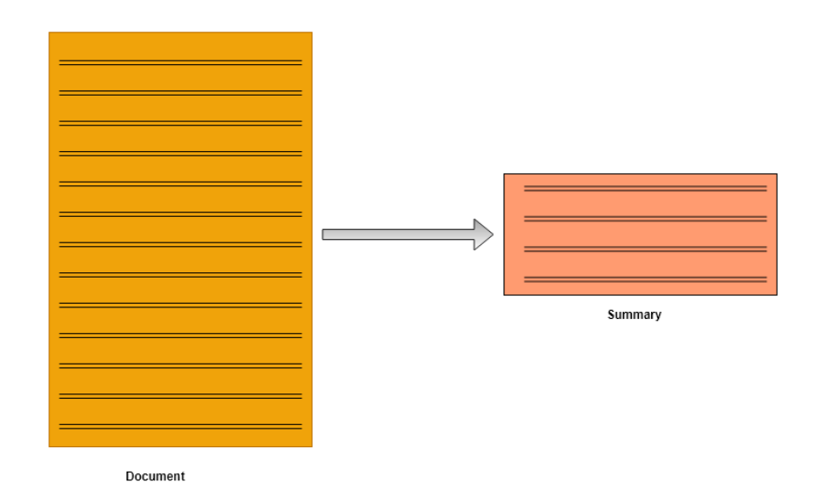
Implementation Details
8

Slide 9
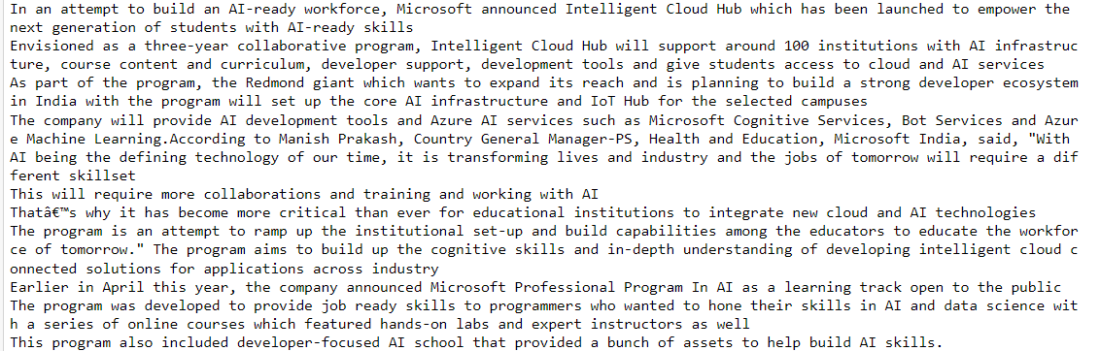
Results
Input:
The obtained classification report showing various\

Slide 10
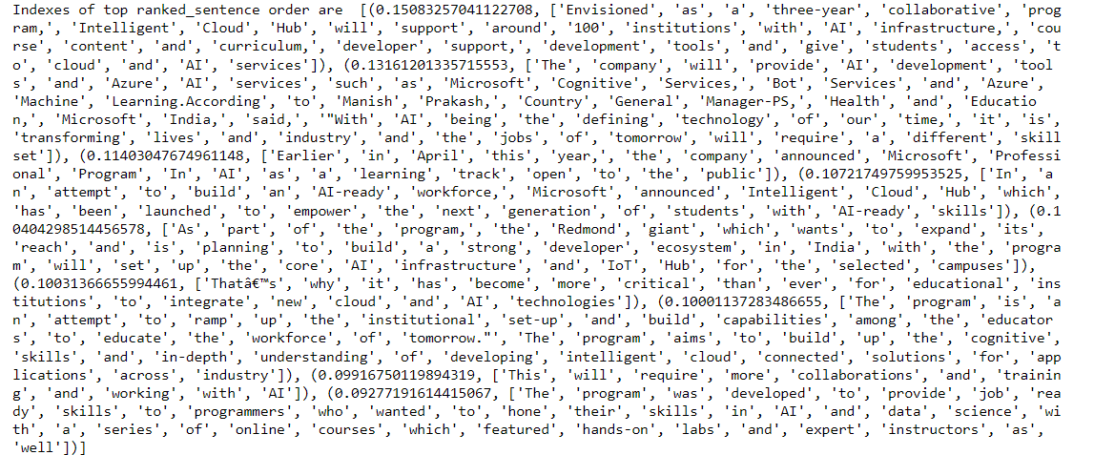
Results
Process:

Slide 11
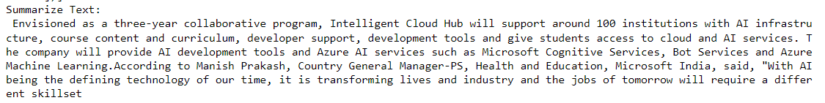
Results
Output:

Slide 12
Conclusion and Future scope
Automatic text summarization is an old challenge but the current research direction diverts towards emerging trends in biomedicine, product review, education domains, emails and blogs. This is due to the fact that there is information overload in these areas, especially on the World Wide Web.Automated summarization is an important area in NLP (Natural Language Processing) research.
It consists of automatically creating a summary of one or more texts. The purpose of extractive document summarization is to automatically select a number of indicative sentences, passages, or paragraphs from the original document .Text summarization approaches based on Neural Network, Graph Theoretic, Fuzzy and Cluster have, to an extent, succeeded in making an effective summary of a document.Both extractive and abstractive methods have been researched. Most summarization techniques are based on extractive methods. Abstractive method is similar to summaries made by humans. Abstractive summarization as of now requires heavy machinery for language generation and is difficult to replicate into the domain specific areas
12

Slide 13
References
https://superkogito.github.io/SER-datasets/
https://towardsdatascience.com/speech-emotion-recognition-with-convolution-neural-network-1e6bb7130ce3
13

Slide 14
Thank You

